Slide 1
The Internet Archive Book Reader and Full Text search in Alma
Yoel Kortick
Senior Librarian

Slide 2
The Internet Archive Book Reader
Our sample records
Creating full text from the images
Searching by full text in Primo
Determining which file types the Internet Archive Book Reader will be used for
Searching by full text in non-Latin text (Hebrew example)

Slide 3
The Internet Archive Book Reader

Slide 4
The Internet Archive Book Reader
Typically a presentation of this nature would begin with a general introduction to what we are talking about: The Internet Archive BookReader in Alma and Primo.
However in this case we will "let the facts speak for themselves" and begin with the configuration, see a sample record, and show how it works.
Let's go to the configuration.

Slide 5
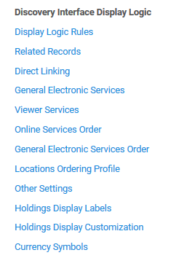
The Internet Archive Book Reader
The Viewer Services page is accessed at "Configuration > Fulfillment > Discovery Interface Display Logic > Viewer Services"

Slide 6
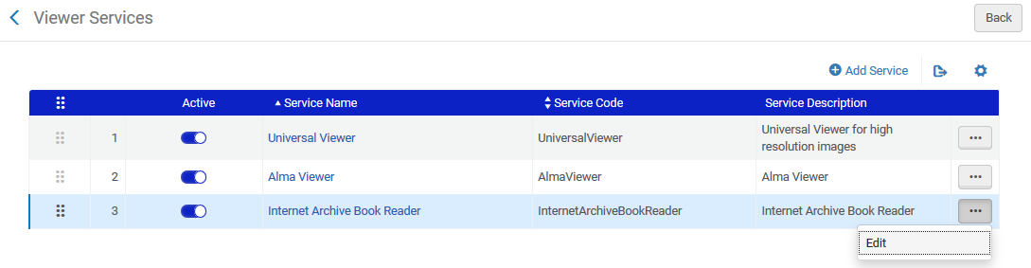
The Internet Archive Book Reader
Edit the Internet Archive Book Reader

Slide 7
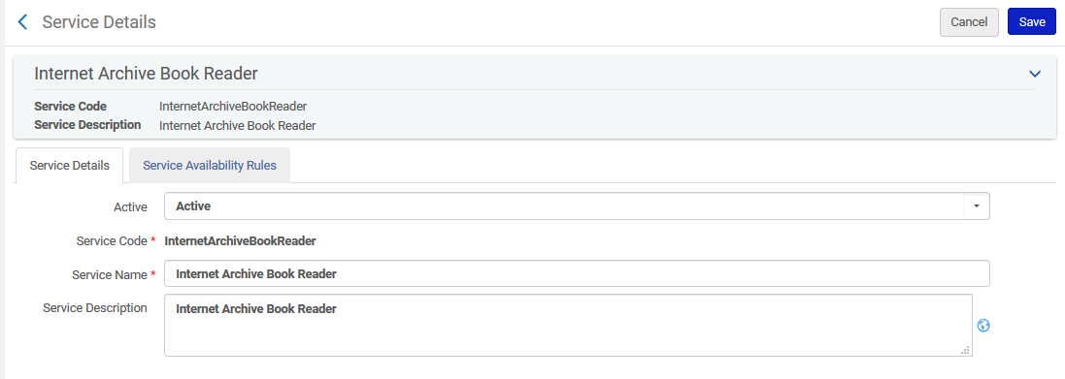
The Internet Archive Book Reader
The Service Code is hard coded.
The Service Name and Service Description can be changed as desired
The Service Description is the text that appears to the end user

Slide 8
The Internet Archive Book Reader
No configuration is necessary other than ensuring that the viewer is active

Slide 9
Our sample record

Slide 10
Our sample record
We have a bibliographic record "Wildflowers of the Holy Land".
It contains one representation with 36 jpg files.
The 36 jpg files were created from a pdf file by converting the pdf to jpg at https://pdf2jpg.net/ (the source of the files is not a necessary step, we are explaining here merely to add context).
The files contain a combination of pictures and text.

Slide 11
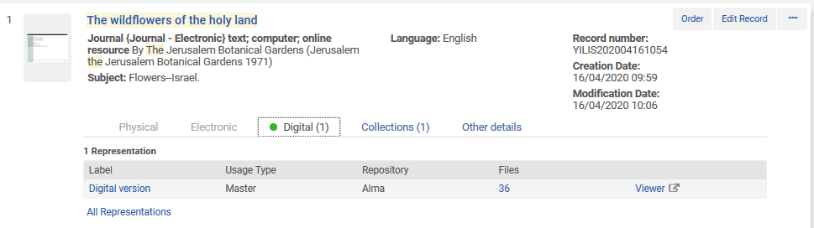
Our sample record

Slide 12
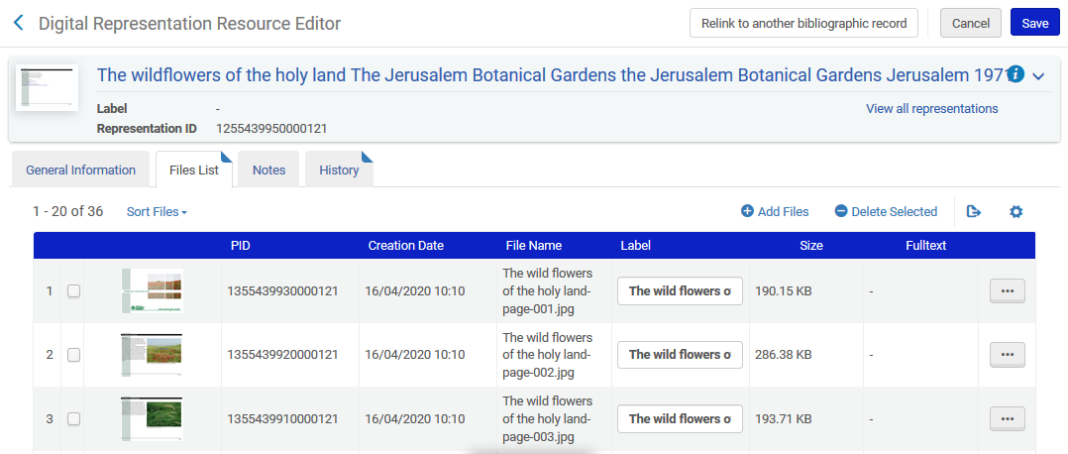
Our sample record

Slide 13
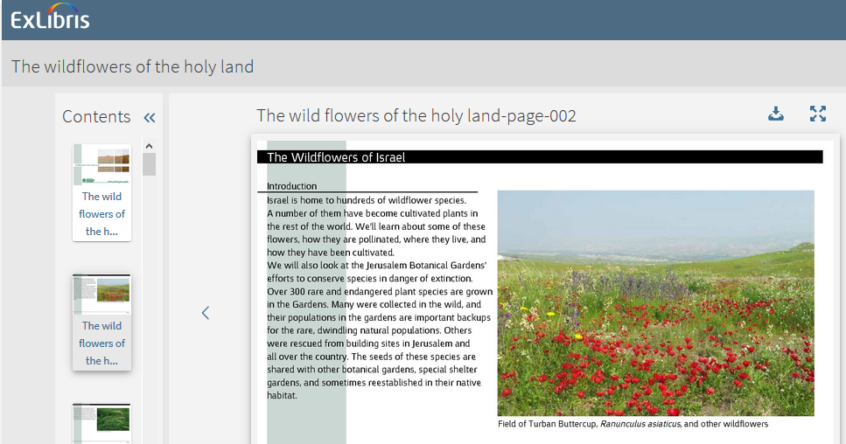
Our sample record
For example this image contains both a picture and text.

Slide 14
Creating full text from the images

Slide 15
Creating full text from the images
In addition to this presentation you may wish to see
Extracting Full Text (OCR) in the Alma Digital Repository
Automating Full text Extraction in the Alma Digital Repository

Slide 16
Creating full text from the images
Alma can extract full text for image files in the following formats: bmp, png, jpg, and tif.
There are two options for creating full text from an image:
One by one (file by file) choosing "actions > full text" for each file
On a set of digital files via the job "Extract Fulltext"
First we will show the "One by one" method and then the "On a set of digital files" method.

Slide 17
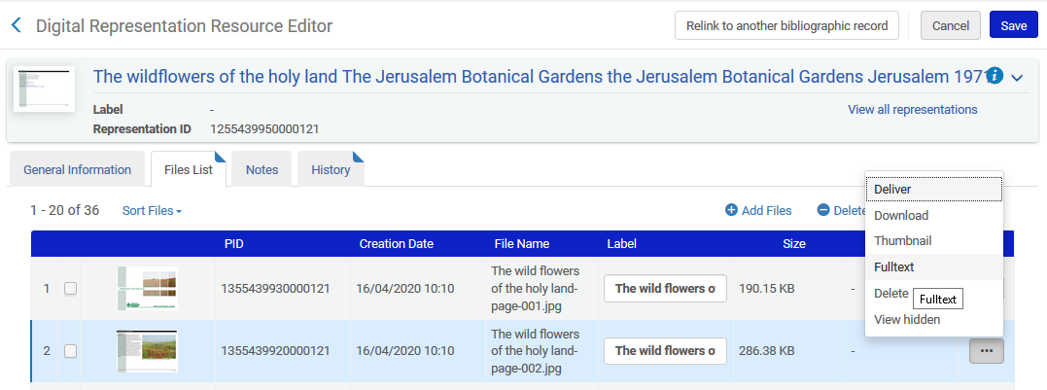
Creating full text from the images - One by one
Open the representation editor, switch to the "Files" tab, do "actions > Fulltext":

Slide 18
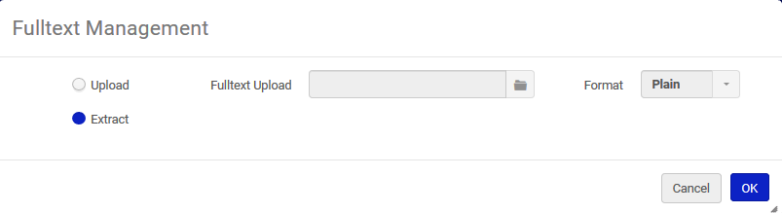
Creating full text from the images - One by one
Choose "Extract" and click "OK"

Slide 19
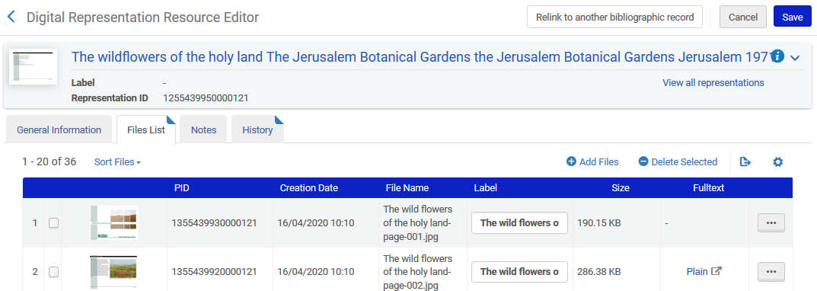
Creating full text from the images - One by one
See that a Fulltext file was created

Slide 20
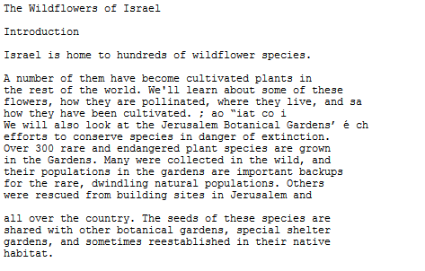
Creating full text from the images - One by one
If the user clicks on the link to the file he or she can see the contents.

Slide 21
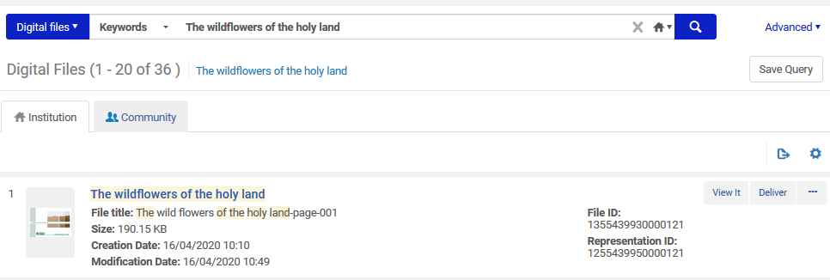
Creating full text from the images - On a set of digital files
Create a set of the digital files

Slide 22
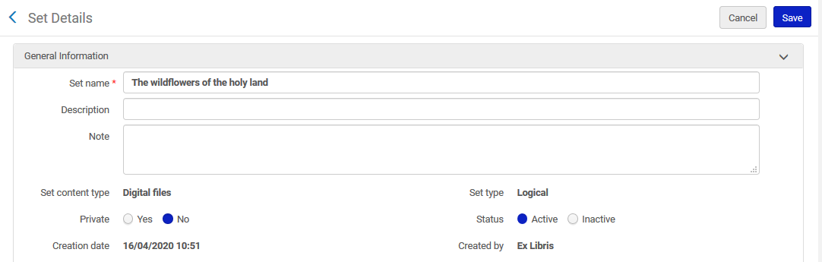
Creating full text from the images - On a set of digital files
Create a set of the digital files

Slide 23
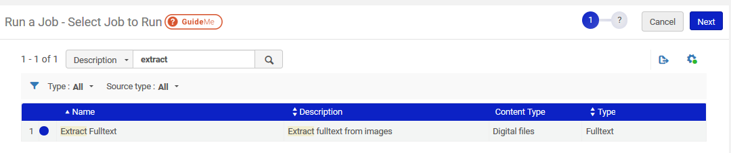
Creating full text from the images - On a set of digital files
Run the job "Extract Fulltext

Slide 24
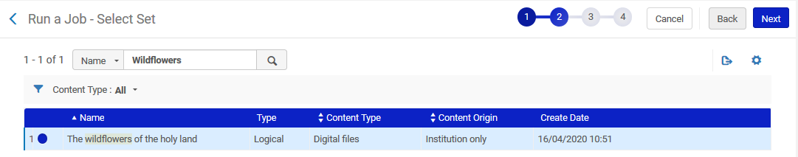
Creating full text from the images - On a set of digital files
Choose the set

Slide 25
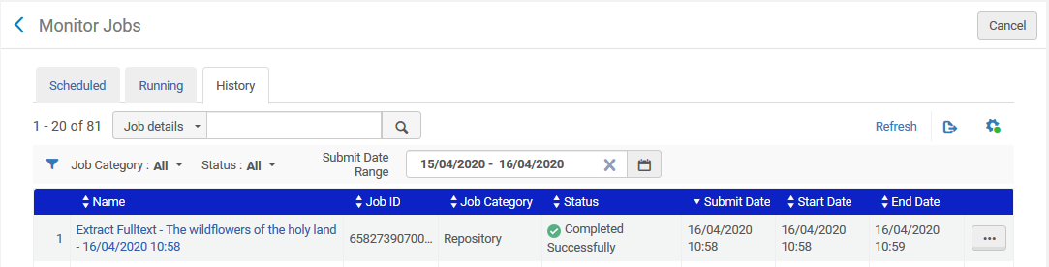
Creating full text from the images - On a set of digital files
The job completes

Slide 26
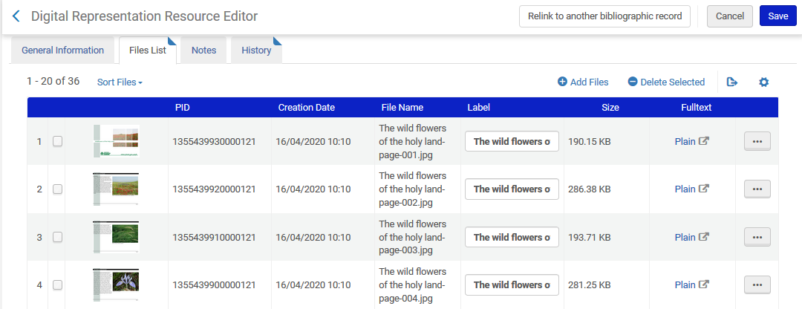
Creating full text from the images - On a set of digital files
Now all files from the set have Fulltext

Slide 27
Searching by full text in Primo

Slide 28
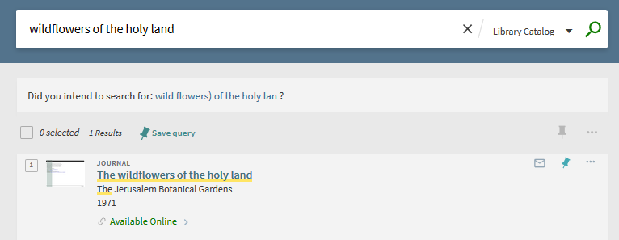
Searching by full text in Primo
We'll search Primo and access the item

Slide 29
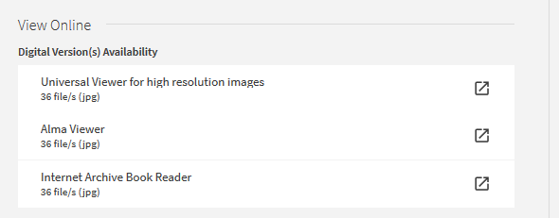
Searching by full text in Primo
Now we will access then Internet Archive Book Reader

Slide 30
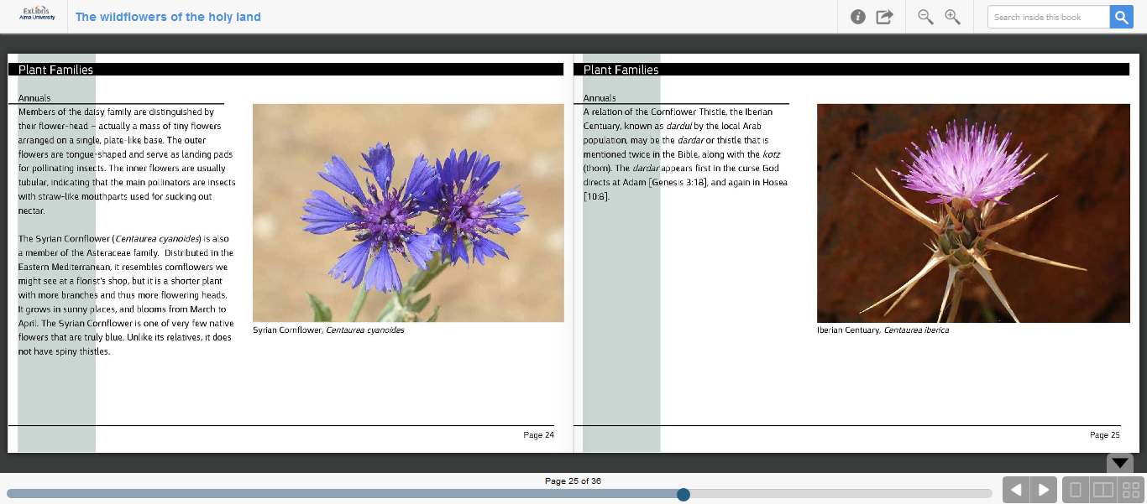
Searching by full text in Primo

Slide 31
Searching by full text in Primo
Full text search box
Click here to more back and forth and "flip the pages"
Use arrows on bottom right or just click a page to "flip" the pages

Slide 32
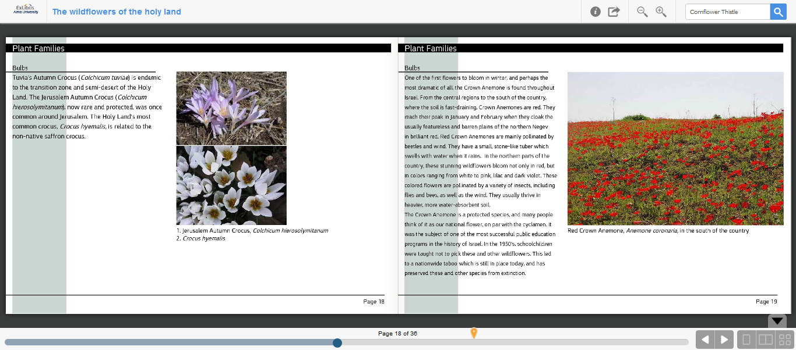
Searching by full text in Primo
We have searched for text "Cornflower Thistle"
Now we have a sign of where in the images the text appears

Slide 33
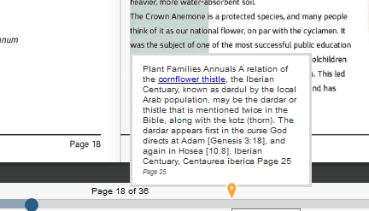
Creating full text from the images
If we hover on the sign it shows the full text and highlights the searched text

Slide 34
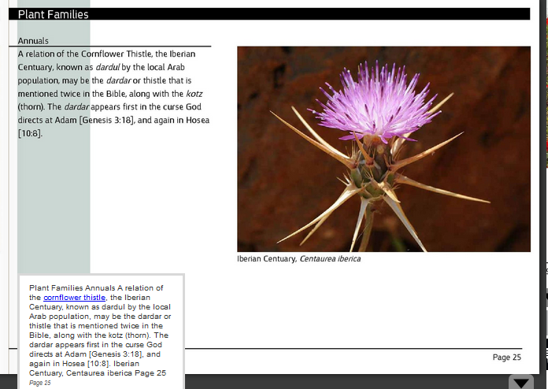
Creating full text from the images
If we click the sign we go to the relevant page

Slide 35
Determining which file types the Internet Archive Book Reader will be used for

Slide 36
Determining which file types the Internet Archive Book Reader will be used for
In the scenario we did here the file was a jpg and the user had the option to choose the Internet Archive Book Reader.
The reason that for the jpg files (as well as for certain other file extension types) the Alma Internet Archive Book Reader was an option is because this file type was defined as "true" in the "Service Availability" tab of the Internet Archive Book Reader.
Based on criteria including the material type of the bibliographic record, the usage type of the representation, and the file type of the representation, it is possible to determine which viewers will and will not appear for a file

Slide 37
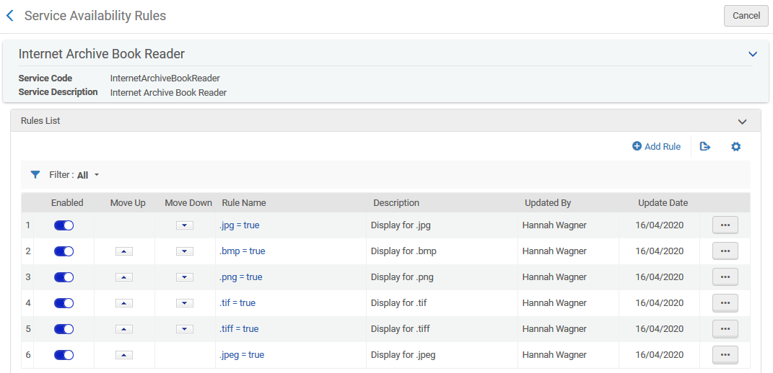
Determining which file types the Internet Archive Book Reader will be used for

Slide 38
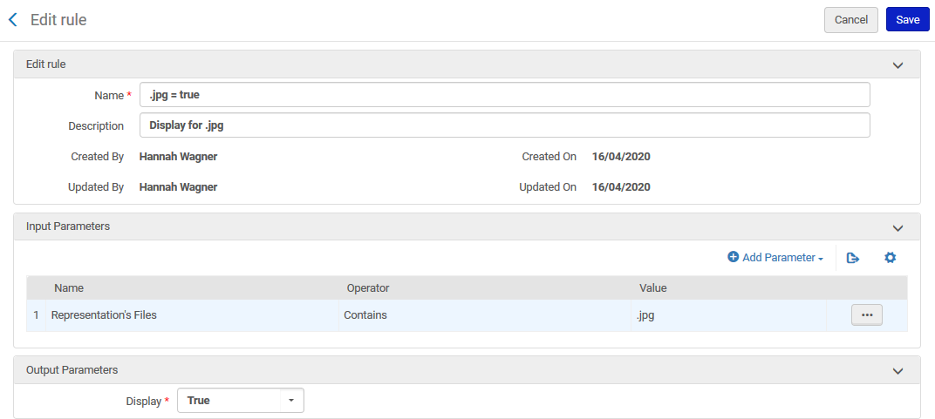
Determining which file types the Internet Archive Book Reader will be used for
In this rule for the Internet Archive Book Reader we state "If the Representation's files contains ".jpg" then display the viewer

Slide 39
Determining which file types the Internet Archive Book Reader will be used for
Note that it is also possible to use a regular expression to make one rule for multiple file types.
Thus for example, instead of one rule for .jpg and one rule for .jpeg and one rule for .bmp and one rule for .png and one rule for .tif and one rule for .tiff, there can be one all inclusive rule cover them all
This is the syntax:
\.bmp|\.png|\.jpg|\.tif|\.jpeg|\.tiff

Slide 40
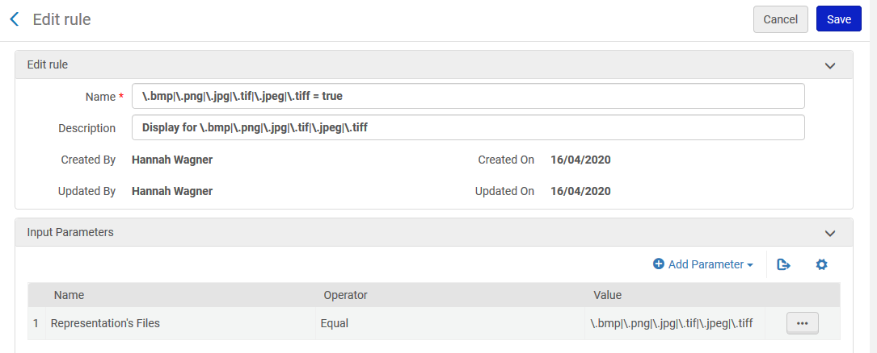
Determining which file types the Internet Archive Book Reader will be used for
One rule for multiple file types

Slide 41
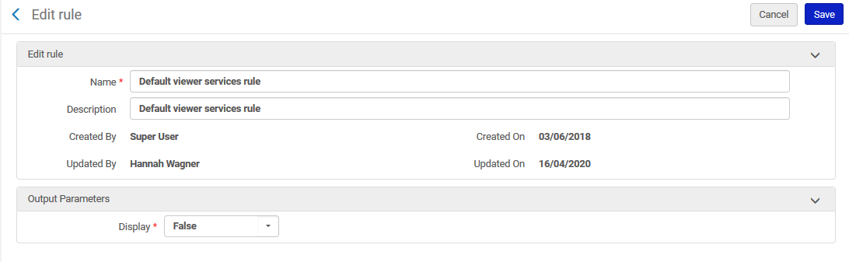
Determining which file types the Internet Archive Book Reader will be used for
The default rule for the Internet Archive Book Reader, which occurs as the last rule after Alma has checked all custom-made rules, it states not to display the Internet Archive Book Reader

Slide 42
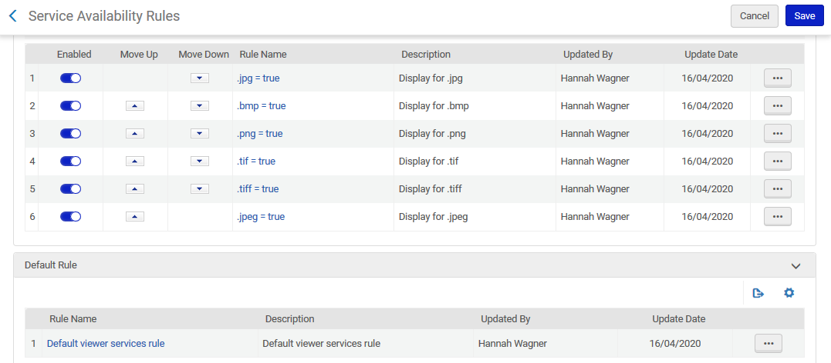
Determining which file types the Internet Archive Book Reader will be used for
First all these get checked
Then this gets checked

Slide 43
Searching by full text in non-Latin text (Hebrew example)

Slide 44
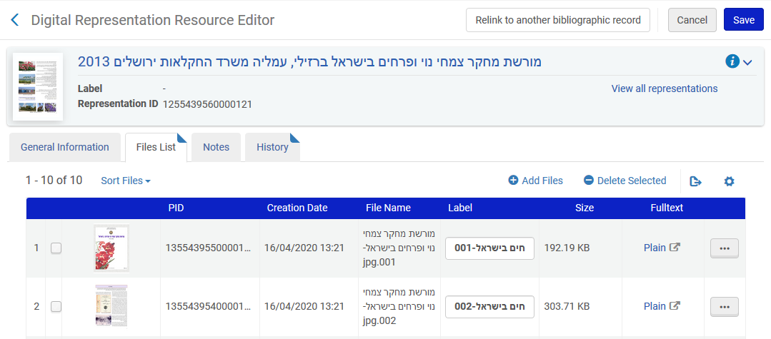
Searching by full text in non-Latin text (Hebrew example)
Here we have a representation with several jpg files with fulltext. The title is מורשת מחקר צמחי נוי ופרחים בישראל

Slide 45
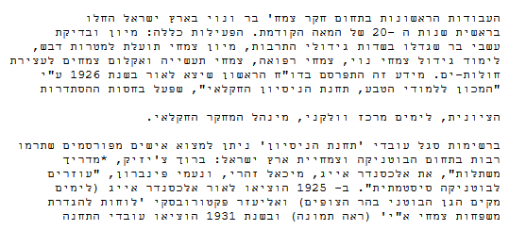
Searching by full text in non-Latin text (Hebrew example)
If we click the link to the fulltext file we see this

Slide 46
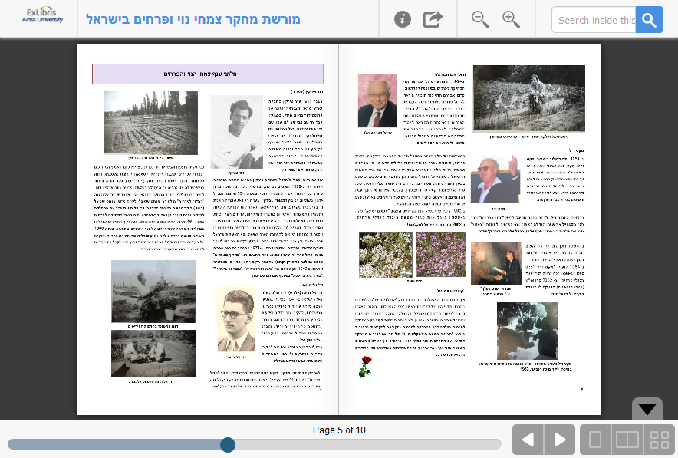
Searching by full text in non-Latin text (Hebrew example)
And in the Internet Archive Book Reader we see the Hebrew text

Slide 47
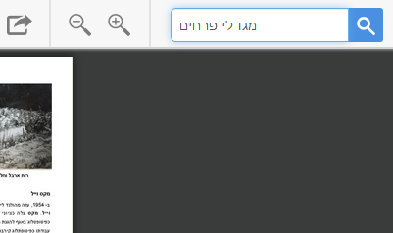
Searching by full text in non-Latin text (Hebrew example)
Now we will perform a full text search in Hebrew

Slide 48
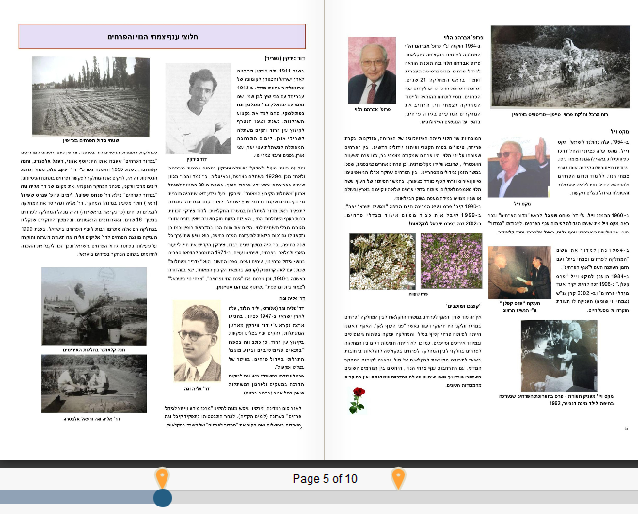
Searching by full text in non-Latin text (Hebrew example)
Two places with the text are found

Slide 49
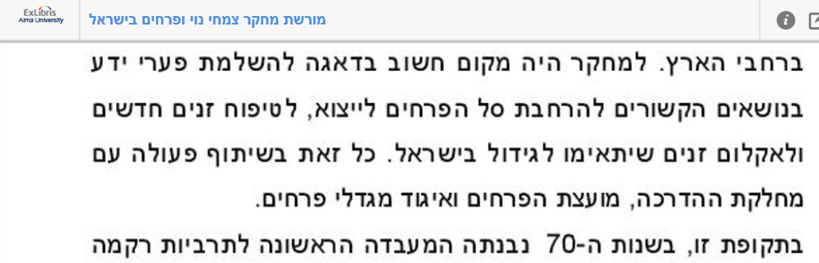
Searching by full text in non-Latin text (Hebrew example)
Here is an example of what was found

Slide 50
Thank you!
xxx@exlibrisgroup.com

